Slide 1
Skin, nails, hair examination

Slide 2
Name the skin layers
Epidermis
Derma
Subcutis

Slide 3
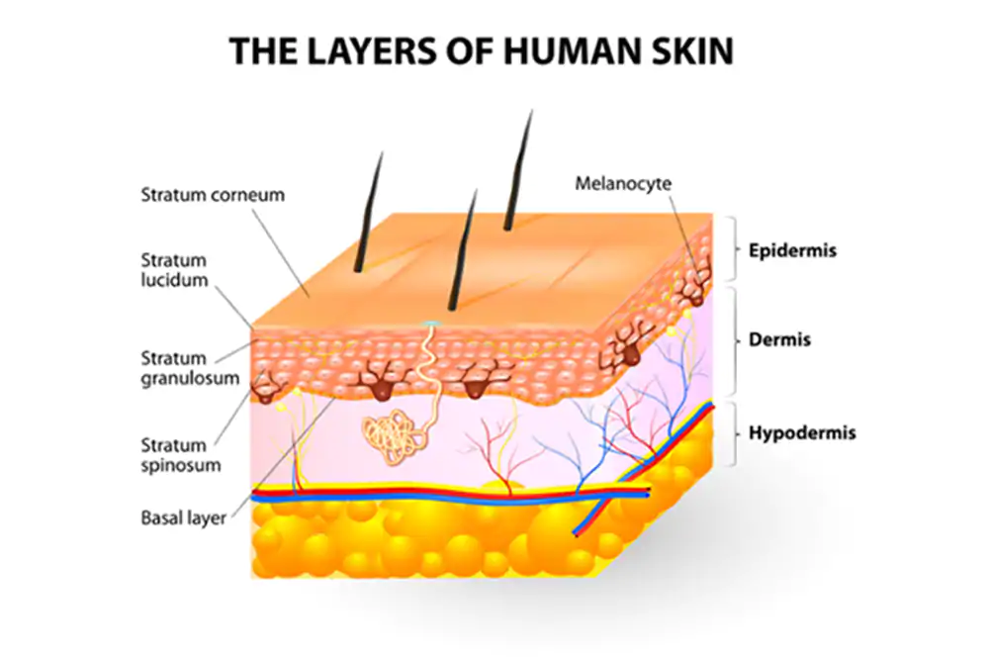

Slide 4
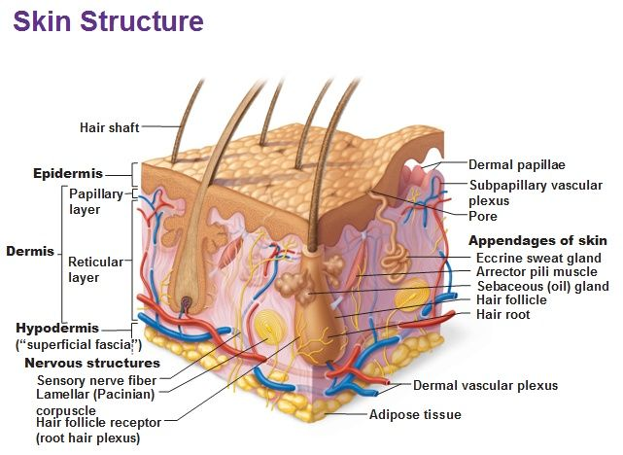

Slide 5
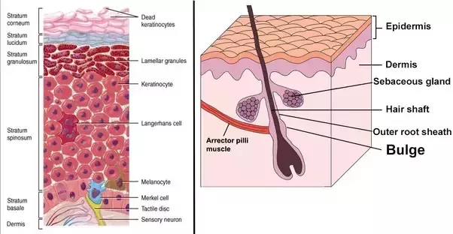
Name the skin cells and special structures

Slide 6
What is skin functions?
Barrier | Against chemicals, particles, microbes, ultraviolet Radiation Against mechanical injury Against loss of body fluids | Mobility | Provides a surface for grip
Homeostasis | Regulation of body Temperature | Metabolism | Role in vitamin D production
Sensation | Touch Temperature Pressure Pain | Immunity | Outpost for immune surveillance
 |  | Psychology | Sexual attraction Self-image

Slide 7
Skin lesions
Location
Itching
Size
Shape
Color
Border changers
Spatial interrelationships: are lesions confluent or separate?

Slide 8
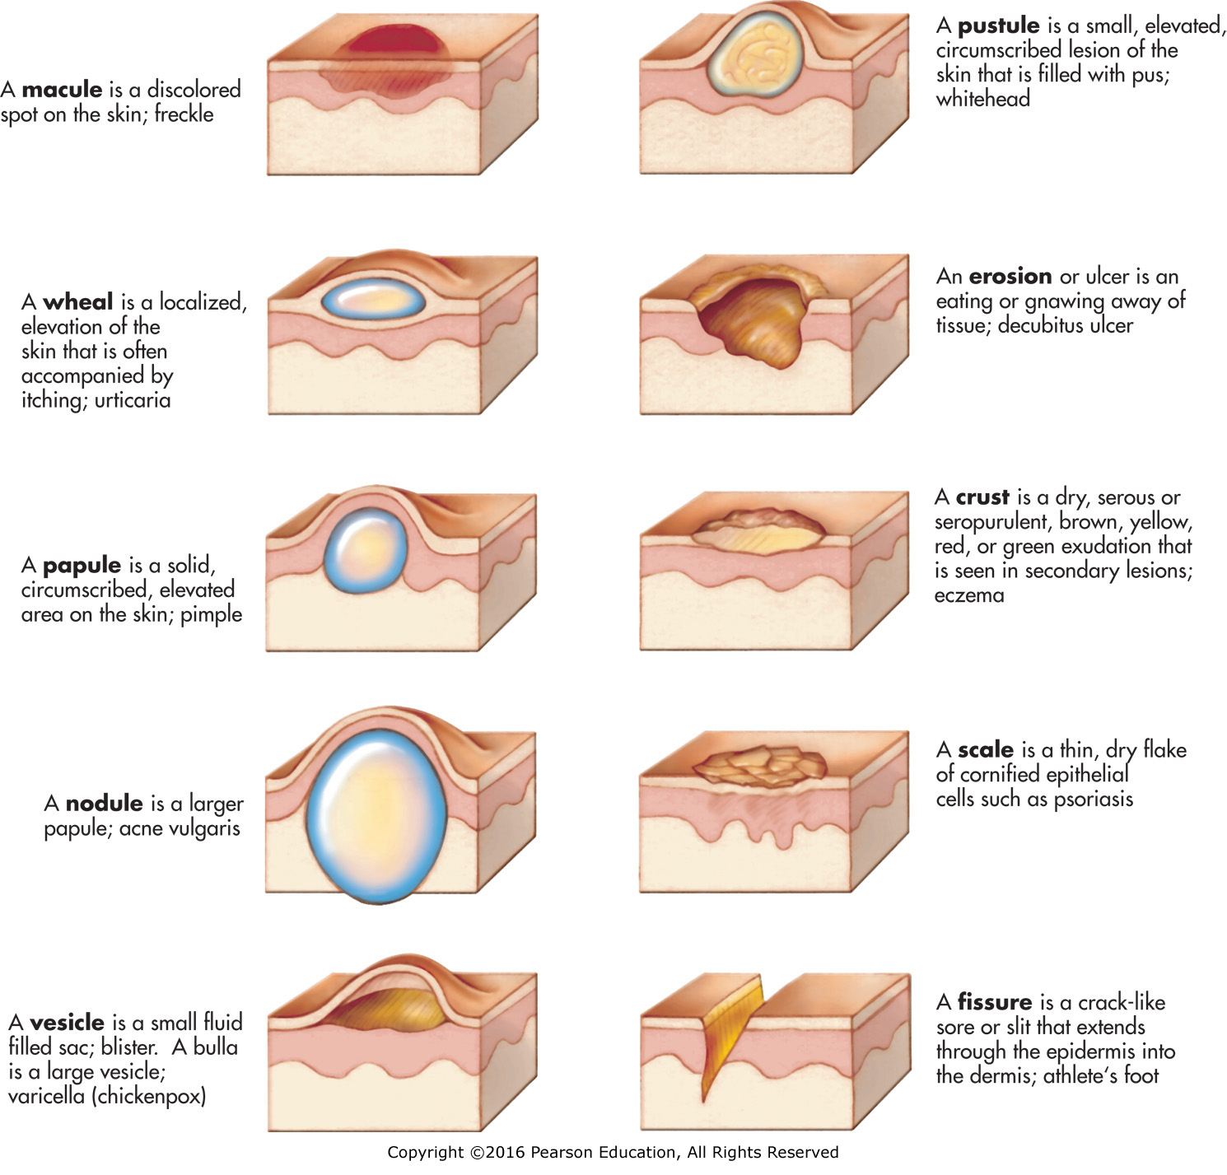

Slide 9
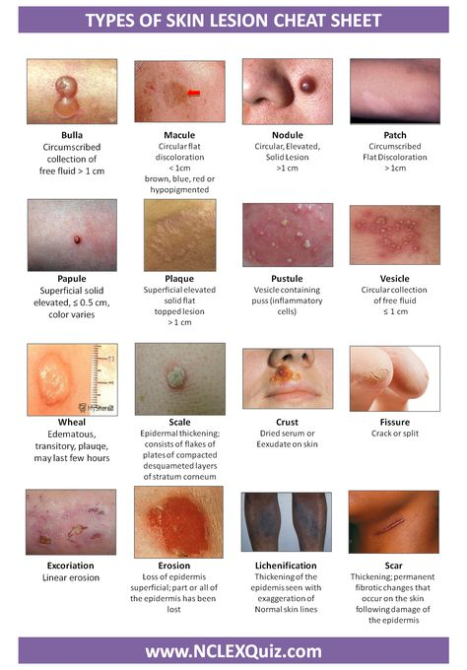

Slide 10
Look at
Nails at hand and feet
Scalp, especially hair growth line
Mucus membrane: eyes (conjunctiva)
lips and mouth
throat

Slide 11
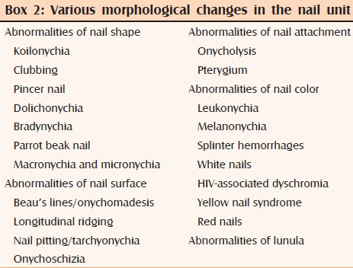
Nails

Slide 12
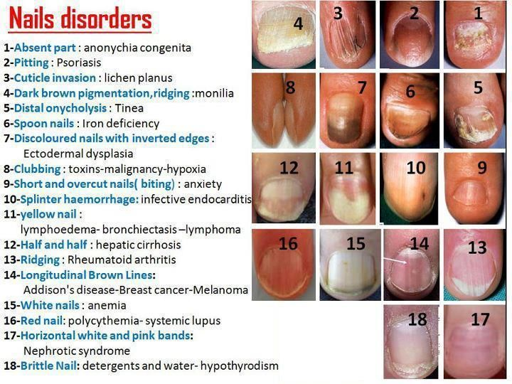
Nails

Slide 13
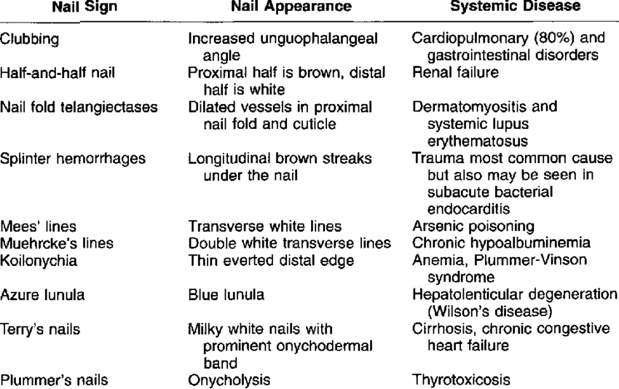

Slide 14
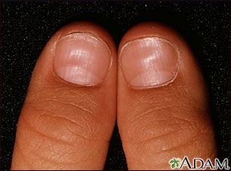
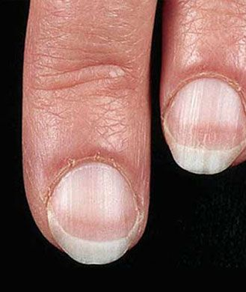
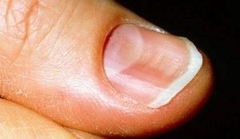

Slide 15
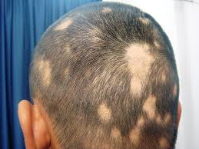
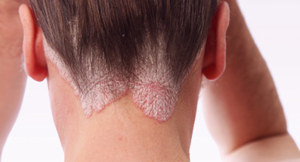
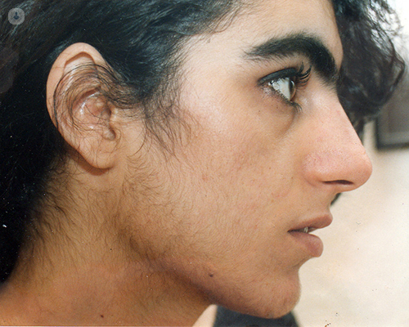
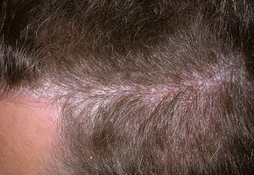

Slide 16
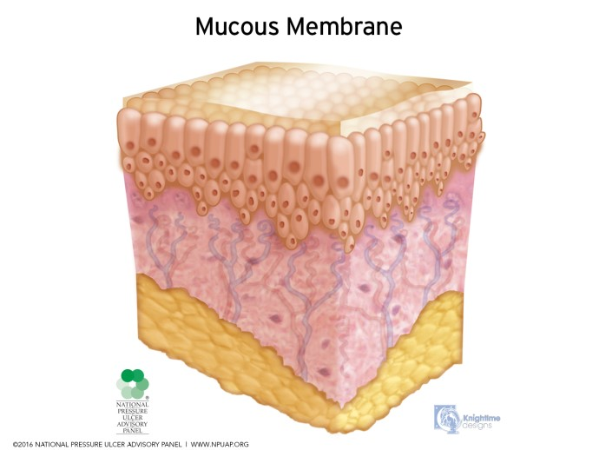

Slide 17
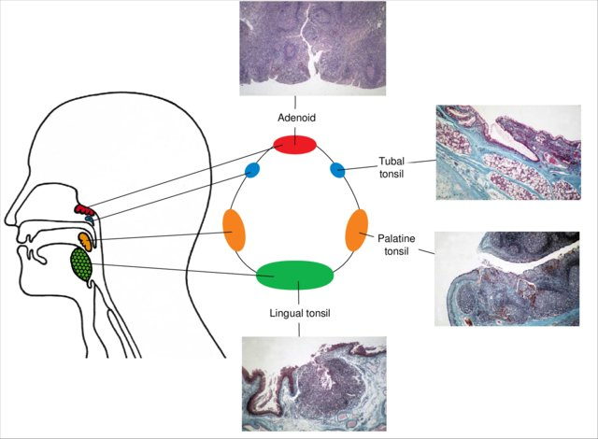

Slide 18
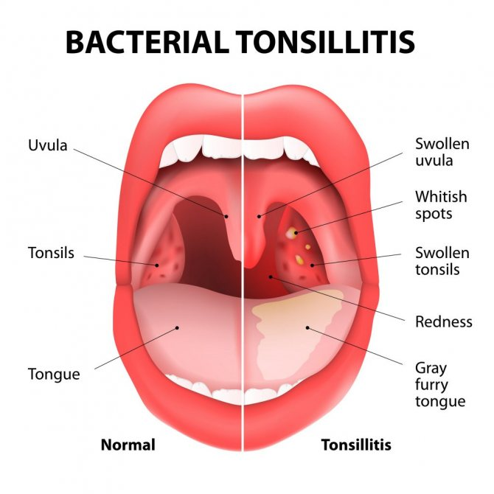

Slide 19
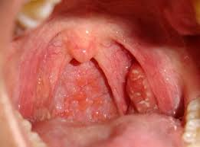
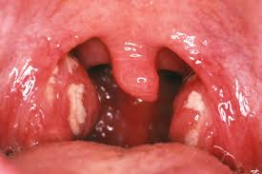
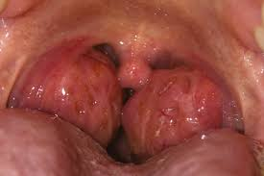

Slide 20
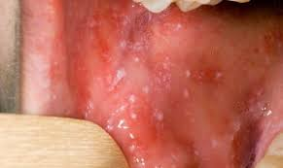
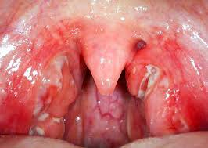

Slide 21
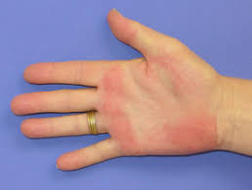
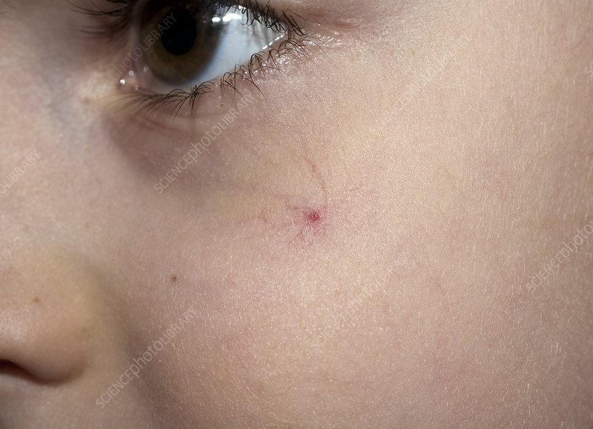
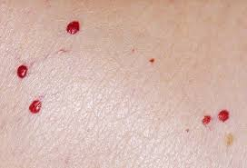
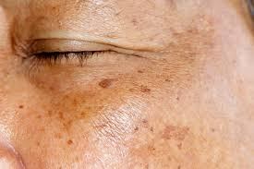
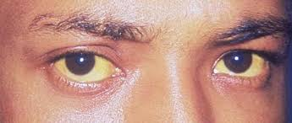
Hepatic sign

Slide 22


Slide 23
